Slide 1




Financial Transactions Dataset Analytics & Insights
Priya Gundepally

Slide 2
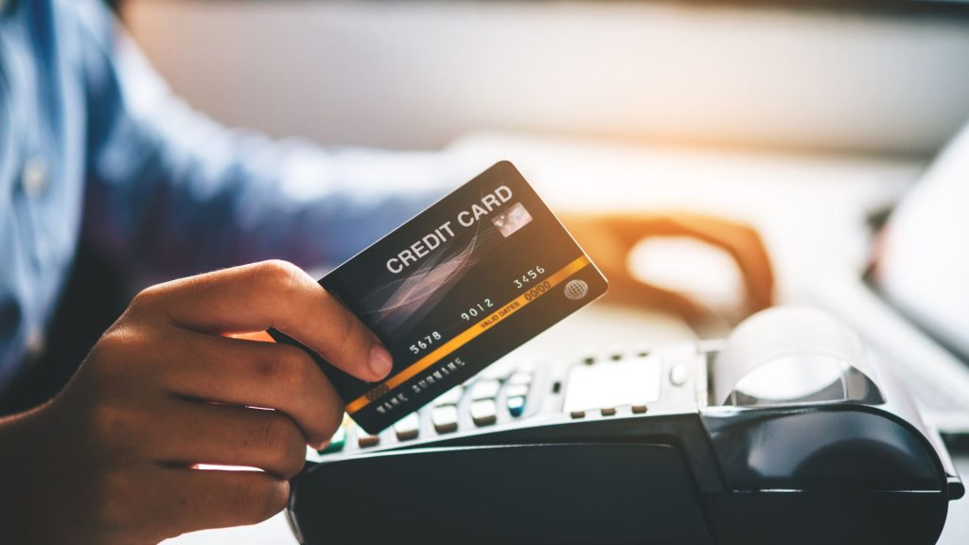


Agenda
01
Overview of dataset
02
Data Cleaning
03
Analytics and Visualization
04
Strategic Value
05
Conclusion

Slide 3
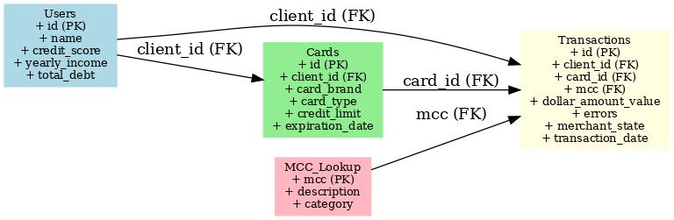





Overview of Dataset
Source: Kaggle
Cards Data(CSV)
User Data(CSV)
Credit and debit card details
13 columns
Column Name: card_type(Debit/Credit), card_brand(Visa/Mastercard/Amex), id
Demographic information about customers
14 columns
Column Name: age, gender, id, yearly_income, num_credit_cards
Transaction Data(CSV)
Mcc_codes Data(json)
Details of transaction records
12 columns
Column Name: amount, merchant_state, merchant_city, date, id
Mapping of Merchant Category Codes (MCC) to categories
Example:
5812: Restaurant
5411: Grocery Stores

Slide 4


Challenges of Data Cleaning
01
Large Dataset
Over 13 million rows of transaction data.
-> Required filtering for relevant insights.
02
Inconsistent Data Formats​
String Storage: Transaction amounts stored as strings
Formatting Issues:
1.Presence of dollar symbols ($), ex: $827
2.Use of parentheses for negative amounts, ex: ($86)
3.Commas in large numbers, ex:1,217
-> Needed conversion for numerical analysis.

Slide 5
Data Cleaning Steps
01
Filter Data by Country
Extracted transactions specific to USA to focus analysis.
Reduced dataset size, improving processing efficiency.
02
Convert Monetary Fields in Transactions, Users & Cards tables
Added a new column to convert amounts from string to decimal format.
Removed dollar symbols, parentheses, and commas
Ensured consistent and accurate numerical computations.
03
Validate Cleaned Data​
Checked for:​
Missing values, formatting issues and outliers.

Slide 6

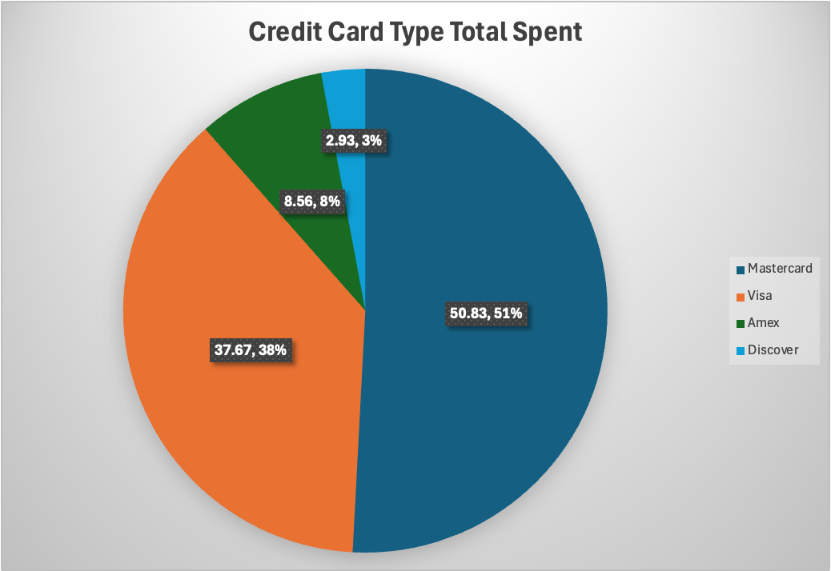
Card Brand Analysis
Top Brands: Mastercard leads with $25.1M (50.83%), followed by Visa with $18.6M (37.67%).
Market Share: Mastercard and Visa dominate with 88.5% of total spending.
Smaller Players: Amex and Discover contribute a combined 11%, with Amex at 8.56% and Discover at 2.93%.

Slide 7
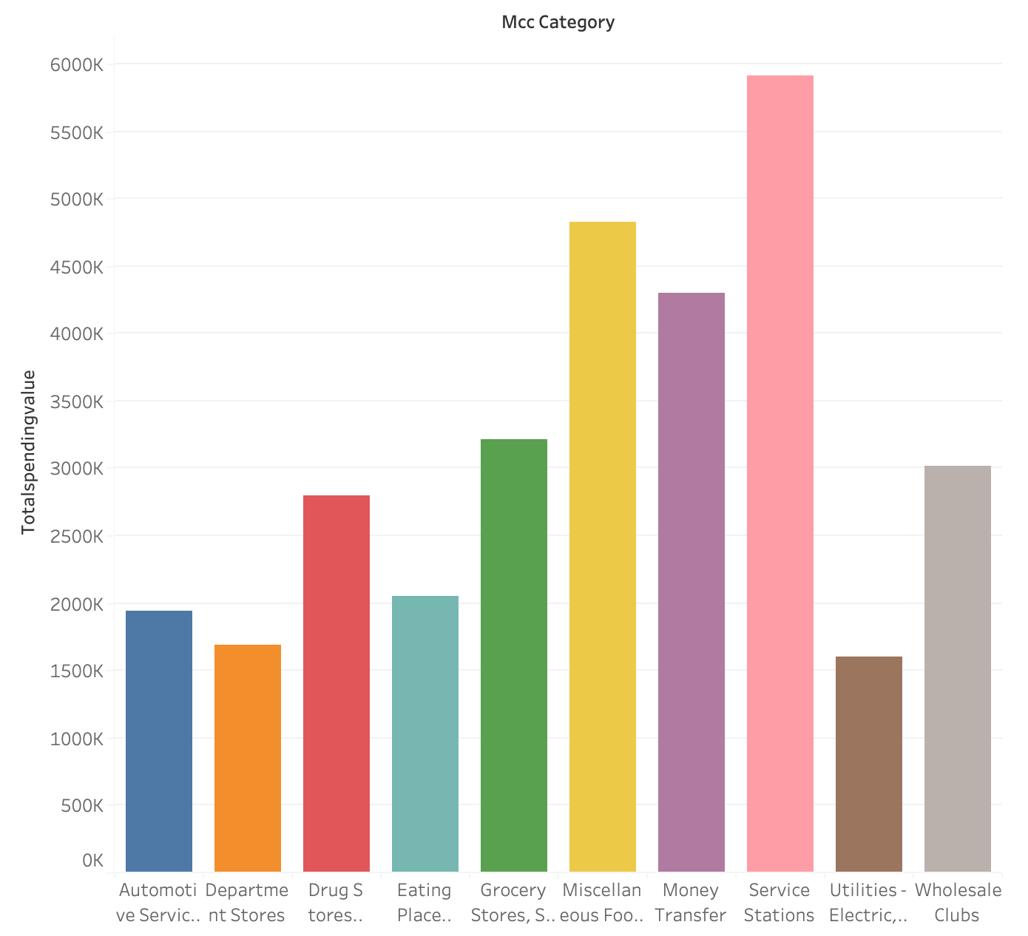
Spending Categories
Combines transaction data with MCC_code by matching MCC_id
Top Spending: Service Stations lead in total spending, reflecting high fuel or travel costs.
Essential Categories: Grocery and Miscellaneous Food Stores also show significant spending, highlighting daily necessities.
Moderate Spending: Drug Stores, Department Stores, and Wholesale Clubs indicate consistent but smaller contributions.
Lower Spending: Utilities and Automotive Services have the lowest totals, likely due to their recurring or infrequent nature.

Slide 8
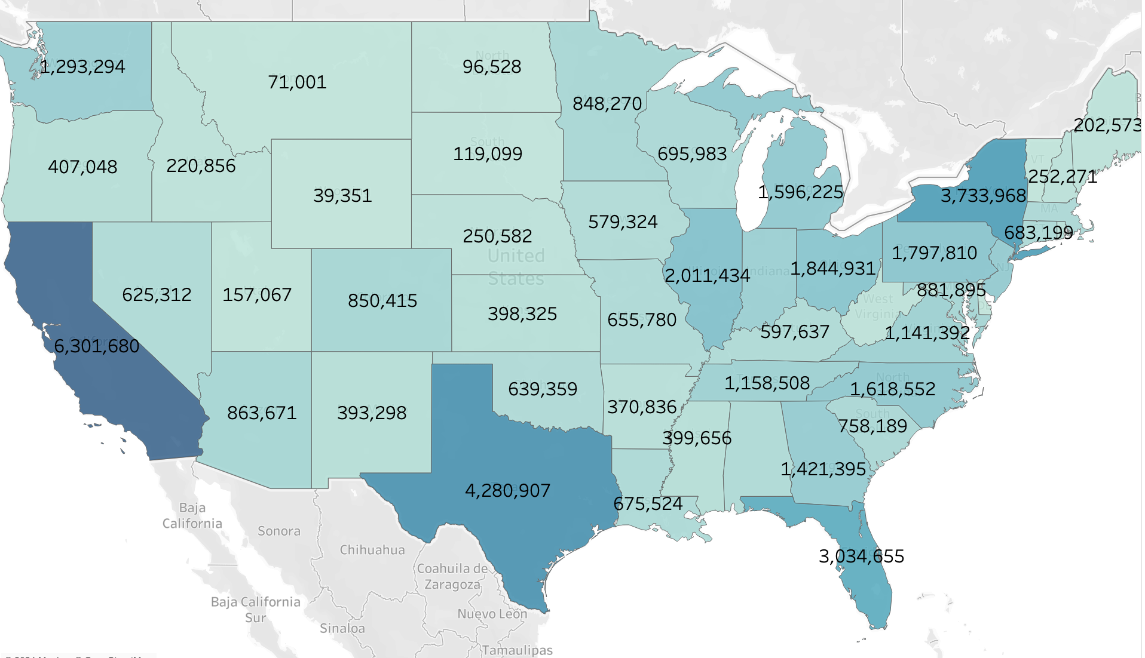
State Spending Analysis
Top Spenders: California ($6.3M), Texas ($4.28M), and New York ($3.73M) lead in spending, driven by large populations and economies.
Lowest Spenders: Wyoming ($39K) and Delaware ($60K) have the least spending, reflecting smaller populations.
Regional Trends: High spending clusters in the West (CA), South (TX, FL), and Northeast (NY, PA); low spending in the Midwest and Mountain regions.

Slide 9
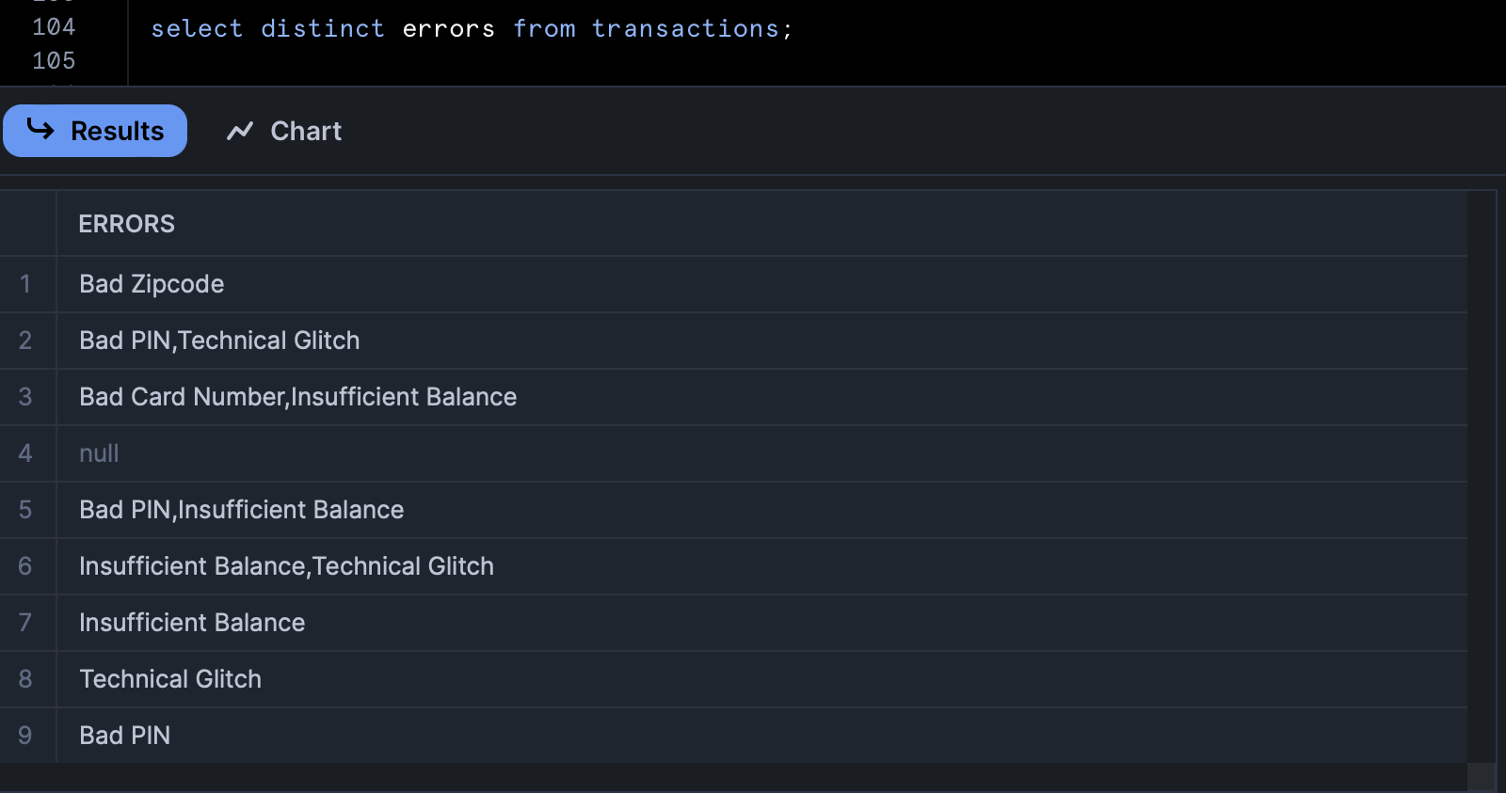
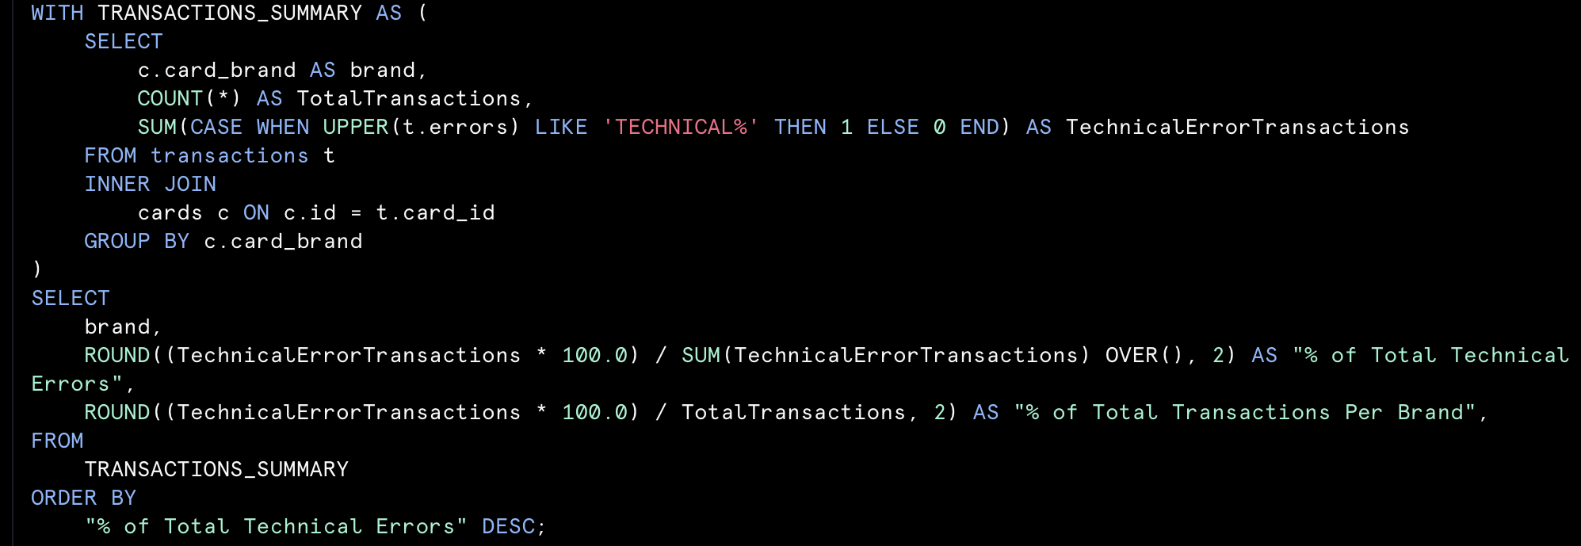
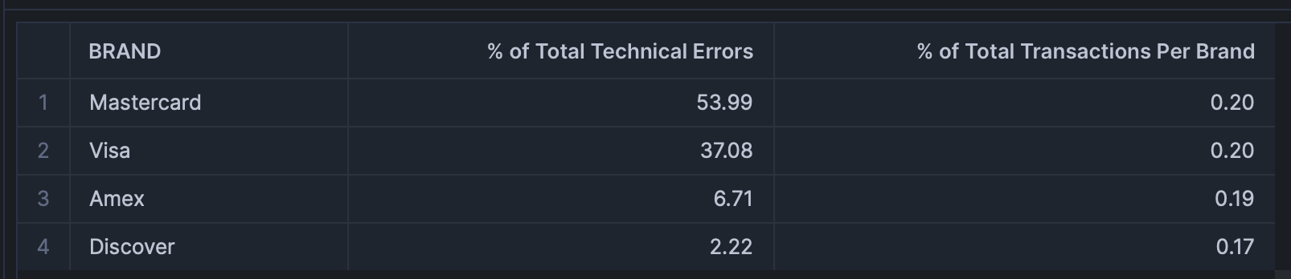
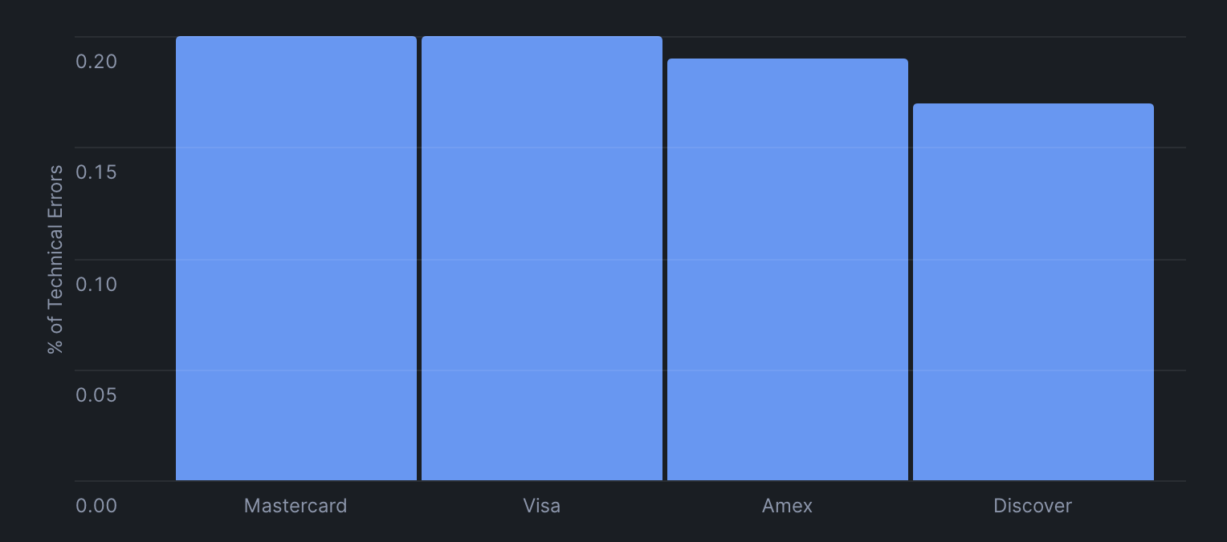
Transaction Error Analysis:
Types of Errors:
We identified 9 distinct types of Error values in transactions table.
Analysis of the Error Type "Technical Glitch":
Discover faces slightly less technical glitches (-0.03%) but handles ~15x Lesser Volumes .
Visa, MasterCard have similar number of technical glitches.
Performance Improvement:
Pre-normalize 'errors' column and convert to uppercase to reduce load when querying.
Indexing/ Clustering on columns like 'errors' when using it for repeated queries.
Query Result:
% of Technical Glitches Vs. Card Network

Slide 10
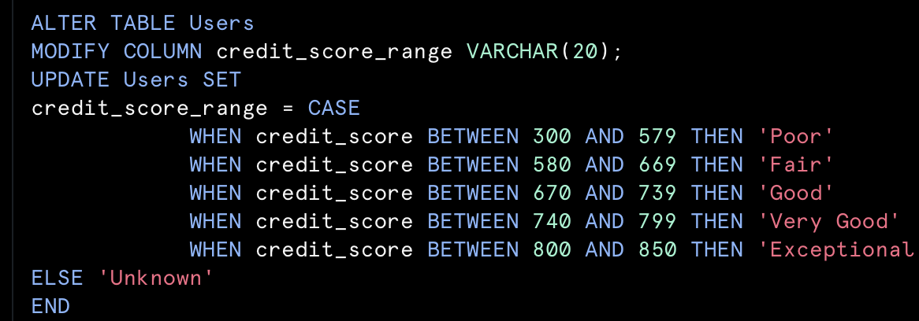
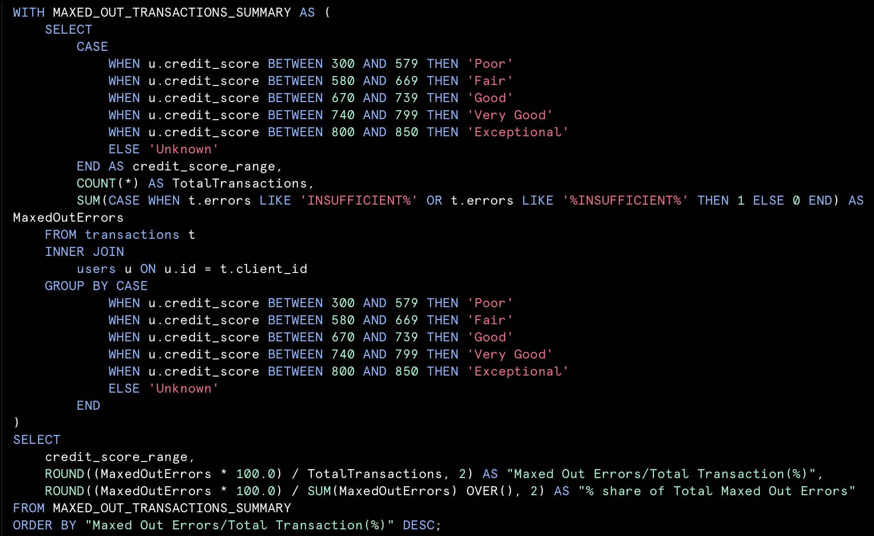
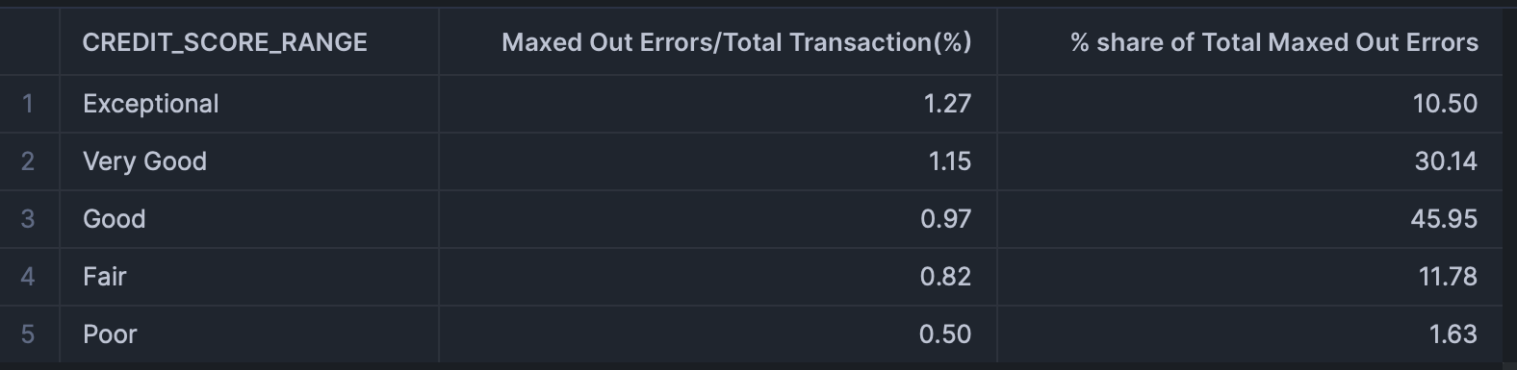
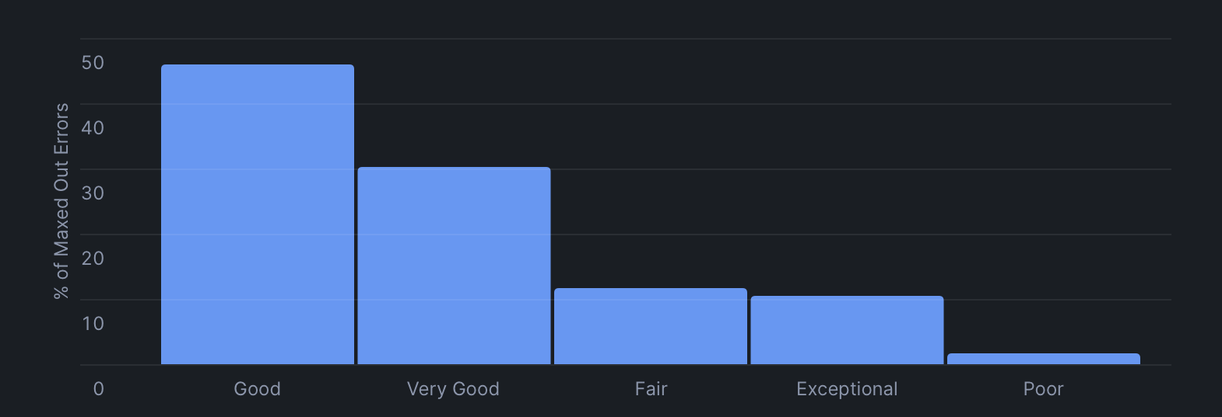
Transaction Error and User Behavior Analysis:
Analysis of Error Type "Insufficient Funds":
Users with 'Exceptional' credit score are relatively more likely to max out.
Users in the 'Very Good' and 'Good' tend to max out their cards at higher rate.
Users in the 'Poor' range (1.63%) contribute the least to total maxed-out errors.
Performance Improvement:
Pre-normalize column 'credit_score' and create column 'credit_score_range' for querying.
Query Result:
% of Maxed Out Errors Vs. Credit Score Range:

Slide 11
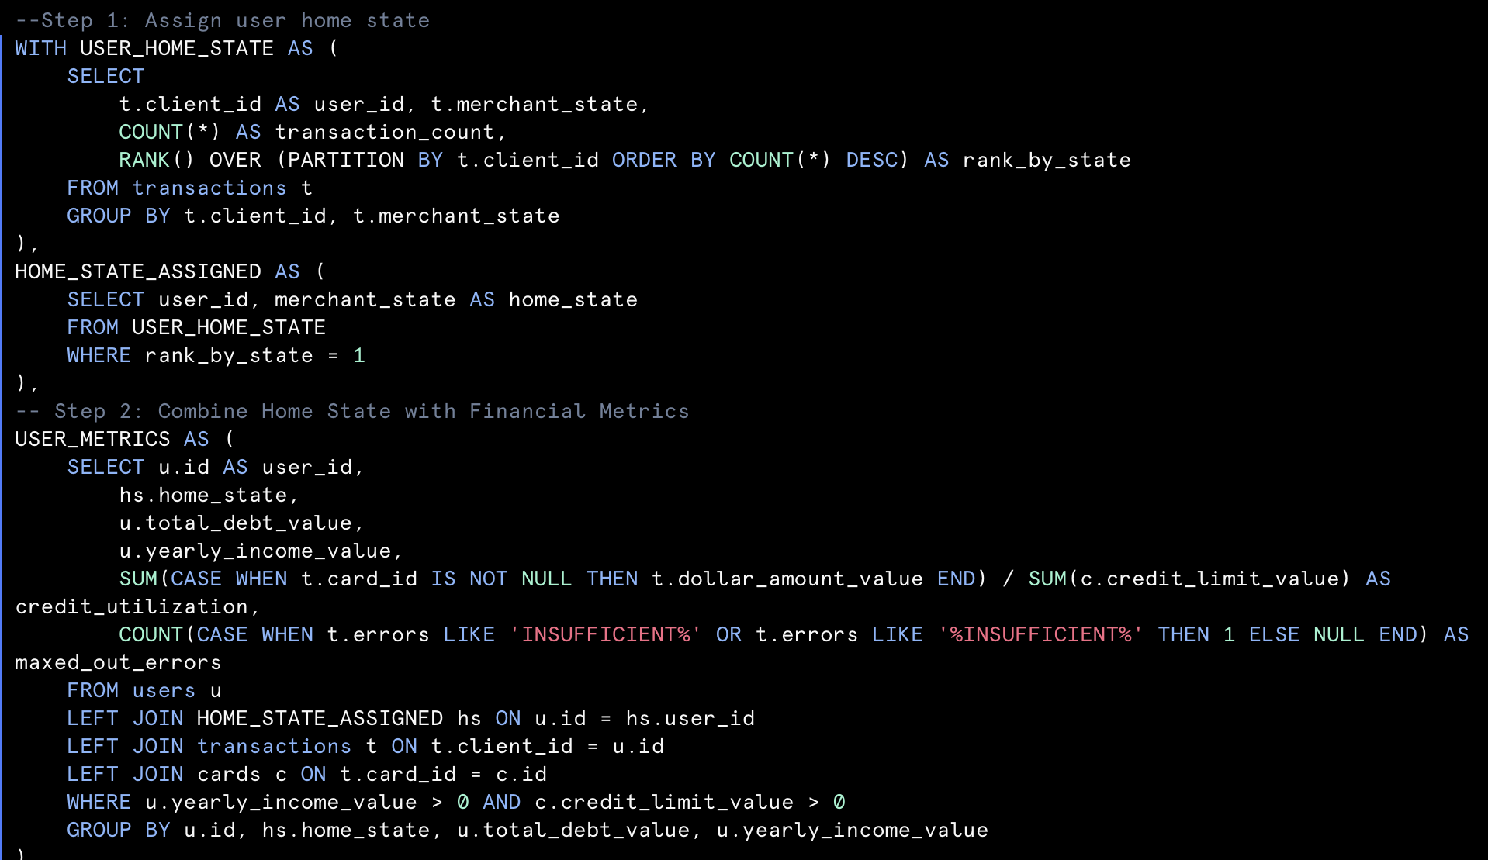
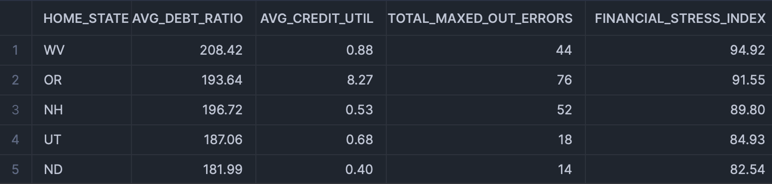
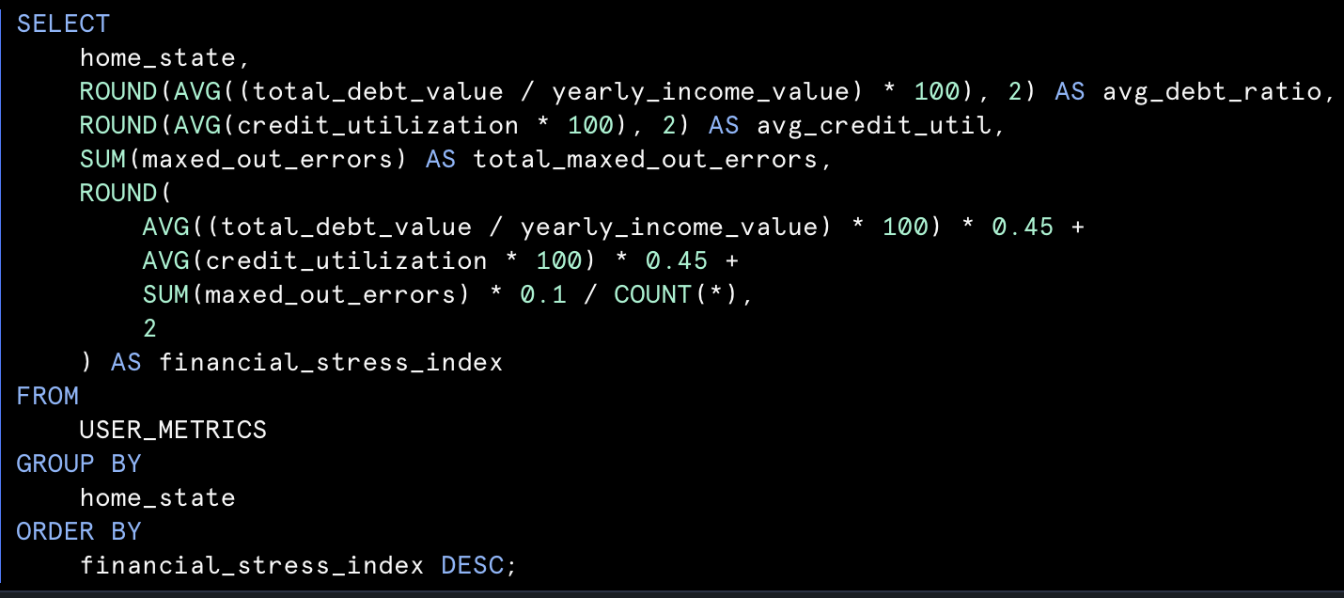
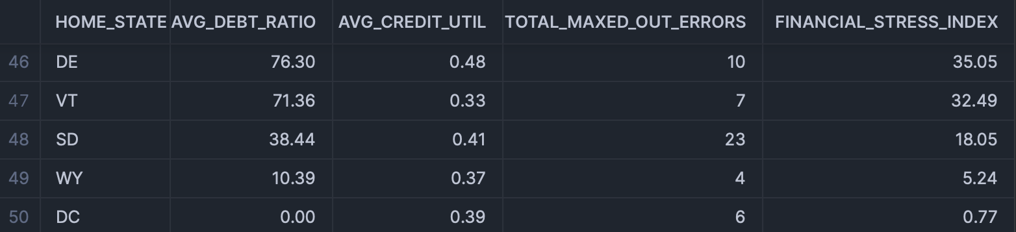
Financial Stress Index For States:
0.45 x (Average Debt Ratio for all users in a state)
0.45 x (Average Credit Utilization for all users in a state)
0.1 x (No. Of Insufficient balance Transactions in a state)
Financial Stress Index =
+
+
Analysis based on FSI:
Highly Financially stable states for bank operations: Delaware, South Dakota, Wyoming, Vermont, DC.
Least Financially stable states for bank operations: West Virginia, Oregon, New Hampshire, Utah, North Dakota.
Query Results:

Slide 12

Strategic Value of Data
Spend Analysis: Reveals regional spending trends, brand loyalty, and areas for growth.
Transaction Errors: Identifies inefficiencies, prioritizes tech fixes, and highlights financially vulnerable segments.
Financial Stability Index: Offers insights into regional financial health to guide resource allocation, marketing, and risk management decisions.

Slide 13


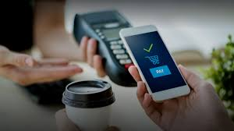

Other useful Data
Is Card on Darkweb
Demographic data
Payment method details
Customer feedback

Slide 14


Conclusion
Our project provides insights into spending analysis by state category and brand, to merchants, banks and card networks for better organization of the resources.
Transaction error analysis will help banks to provide overdraft facilities to customers with strong credit scores.
The financial stability index helps banks to decide which states are more suitable for business expansion.
Cards table has a column "is_card_on_dark_web". Unfortunately our dataset had his value as FALSE, if we had this data – we could better analyze how fraudulent transactions take place.

Slide 15

Appendix

Slide 16
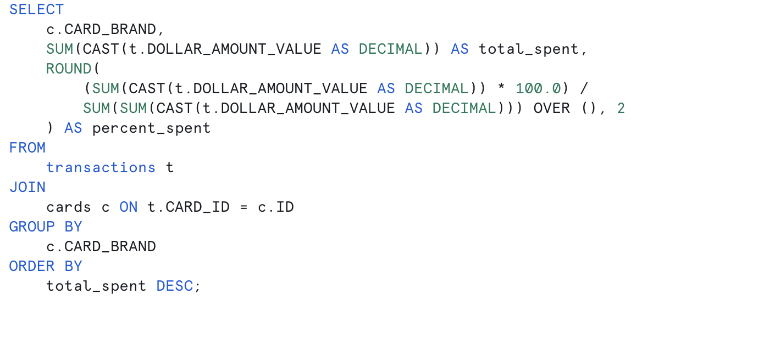
Total Spending Analysis per card brand

Slide 17
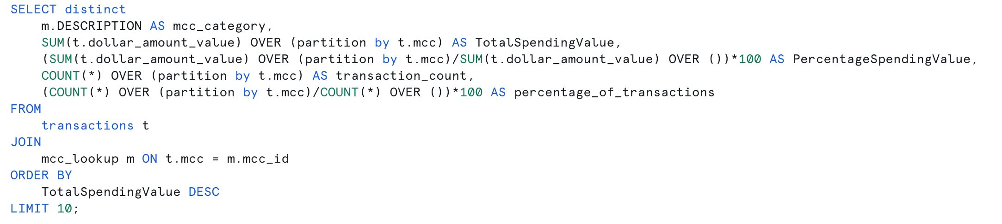
Spending Analysis per category

Slide 18
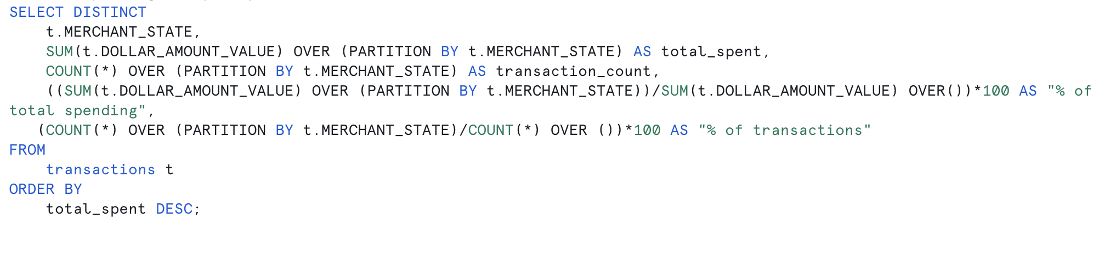
Total Spending Analysis per state

Slide 19
Transaction Error Analysis

Slide 20
Transaction Error and User Behavior Analysis

Slide 21
Financial Stability Index For States(1/2)

Slide 22

Financial Stability Index For States(2/2)

Slide 23
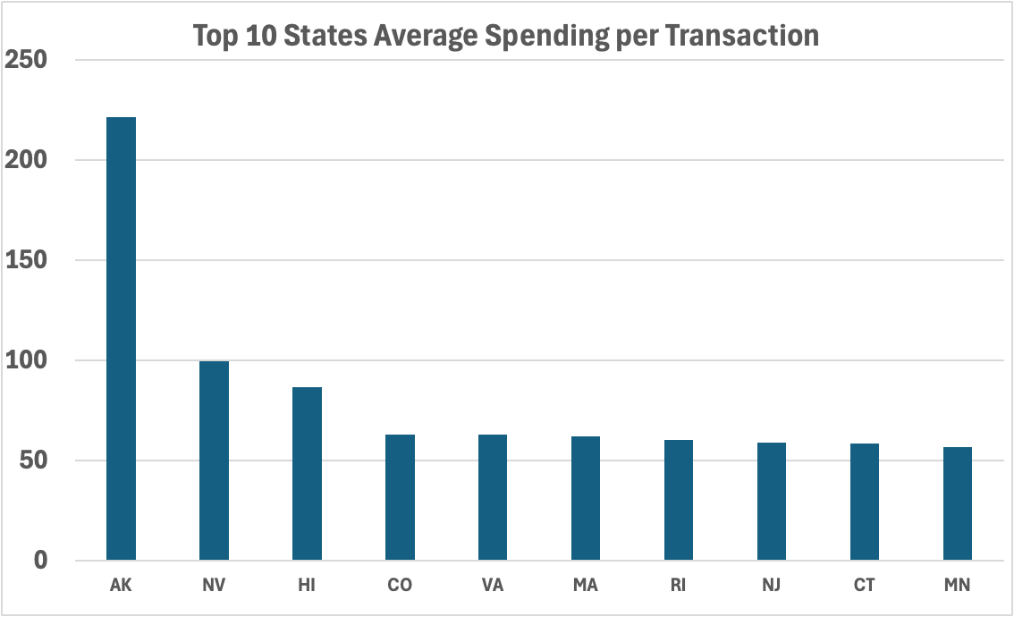
State Spending Analysis
Top 10 Spending Category in AK
MCC Category | TOTAL_SPENDING | TRANSACTION_COUNT
Computer Network Services | 138685.82 | 529
Pottery and Ceramics | 4619.86 | 5
Gardening Supplies | 2069.81 | 7
Heat Treating Metal Services | 1789.34 | 6
Electroplating, Plating, Polishing Services | 1321.51 | 6
Miscellaneous Food Stores | 1221.61 | 22
Service Stations | 1169 | 22
Ironwork | 1103.56 | 3
Welding Repair | 1063.2 | 6
Eating Places and Restaurants | 873.58 | 22

